Slide 1
ENERGY EFFICIENT HOME MONITERING SYSTEM
-HU21CSEN0200109
-HU21CSEN0200041
-HU21CSEN0200042
-HU21CSEN0200134
Guided by: DR.Sudeepthi Govathoti

Slide 2

Contains
Abstract
Introduction
Block diagram
Proposed system
Hardware requirements
Software requirments
Results
conclusion

Slide 3
INTRODUCTION
The integration of Bluetooth technology, temperature sensors, and Light Dependent Resistors (LDR) in home automation systems has paved the way for smart and energy-efficient living environments.
This abstract provides an overview of a home automation system that leverages these technologies to enhance comfort, security, and energy conservation within residential spaces.
The core components of this system include Bluetooth-enabled devices (smartphones, tablets, etc.), temperature sensors, and LDR sensors. Bluetooth serves as the communication interface between users and the home automation system, enabling remote control and monitoring. Temperature sensors continuously measure the ambient temperature, allowing for intelligent climate control and energy optimization. LDR sensors detect changes in ambient light levels, facilitating adaptive lighting schemes that align with natural lighting conditions.
Through a dedicated mobile application, users can connect to their home automation system via Bluetooth, providing real-time access to various functionalities.

Slide 4
Abstarct
The foremost aim of technology has been to increase efficiency and decrease effort. With the advent of ‘Internet of Things’ in the last decade, we have been pushing for ubiquitous computing in all spheres of life.
It thus is of extreme importance to simplify human interfacing with technology. Automation is one such area that aims that achieves simplicity whilst increasing efficiency. Voice controlled House Automation System aims to further the cause of automation so as to achieve the goal of simplicity .

Slide 5

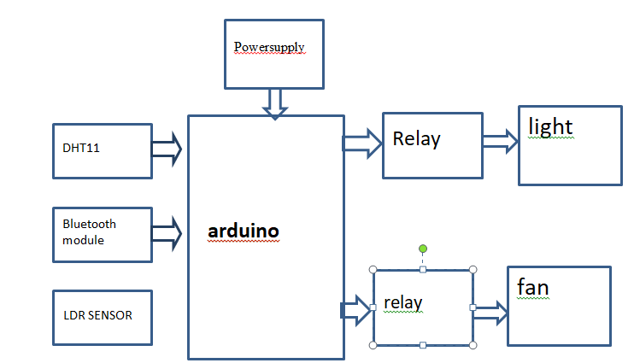
Block diagram

Slide 6
Hardware requments
ARDUINO UNO
LDR SENSOR
DHT11 SENSOR
ADOPTORS
RELAY
DC FAN
BULB

Slide 7
SOFTWARE
ARDUINO IDE
EMDEDDED C PROGRAMMING
WINDOWS OS

Slide 8
Proposed system
Wireless innovation, temperature sensors, and Light Ward Resistors (LDR) in home mechanization frameworks has made ready for savvy and energy-productive residing conditions.
This theoretical gives an outline of a home robotization framework that use these innovations to improve solace, security, and energy preservation inside private spaces.
The center parts of this framework incorporate Bluetooth-empowered gadgets (cell phones, tablets, and so on), temperature sensors, and LDR sensors. Bluetooth fills in as the correspondence interface among clients and the home mechanization framework, empowering controller and observing. Temperature sensors constantly measure the surrounding temperature, taking into consideration canny environment control and energy advancement.
LDR sensors recognize changes in surrounding light levels, working with versatile lighting plans that line up with regular lighting conditions. Through a devoted versatile application, clients can interface with their home robotization framework by means of Bluetooth, giving constant admittance to different functionalities. These functionalities incorporate changing indoor regulator settings in view of temperature readings, somewhat enacting lighting framework

Slide 9
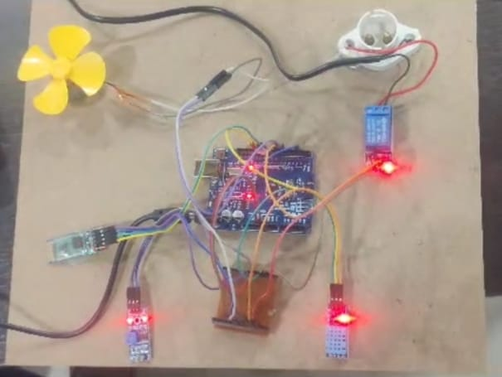
Results

Slide 10
Conclusion
In conclusion, sensors and Bluetooth-based home automation represent a transformative leap in modern living. These technologies have revolutionized the way we interact with our homes, enhancing convenience, energy efficiency, and security. By seamlessly connecting devices and appliances, they provide a unified ecosystem where homeowners can effortlessly control and monitor their environment. From adjusting thermostats to managing lighting and security systems, the integration of sensors and Bluetooth connectivity has not only streamlined daily tasks but also contributed to a more sustainable and comfortable lifestyle. As these technologies continue to advance, the future of home automation promises a smarter, more connected, and efficient dwelling for individuals and families alike.

Slide 11
References
[1]. http://opensourceecology.org/wiki/Automation
[2]. S. Suganya, R. Sinduja, T. Sowmiya& S. Senthilkumar, Street light glow on detecting vehicle movement using sensor
[3]. K.Santha Sheela,S.Padmadevi, Survey on Street Lighting System Based On Vehicle Movements
[4]. Srikanth M, Sudhakar K N,ZigBee Based Remote Control Automatic Street Light System

Slide 12
THANKYOU

